Slide 1

Colony Cruiser: The Maria (Concept Fase)
Epsilon Studios

Slide 2
Voorstellen groep
Producer: Fahrettin Güngör (manage project, Helicopter view, probleem oplossen)
Lead Developer: Mack Mendes Moreira (aansturen developers, overzicht scripts, consistentie)
Lead Artist: Ruben de Water (art style consistentie, back-ups maken)
Level Designer: Lara van Hezel (creativiteit in levels, 2 wekelijks import assets)
User Experience: Kevin de Greef (flow in de game, HUD, look and feel met concept)
Planningsmanager: Fahrettin Güngör (planning, workflow, assetlist maken)
Quality Assurance: Mack Mendes Moreira (bugs omschrijven, game testen om bugs te vinden)

Slide 3
inhoudsopgave
GDD
Introstory
Uitleg Zones
Game Mechanics
Enemies
Creativiteit
Art Style
Backlog
Trello
UX / Leveldesign
Scripting
Doel

Slide 4
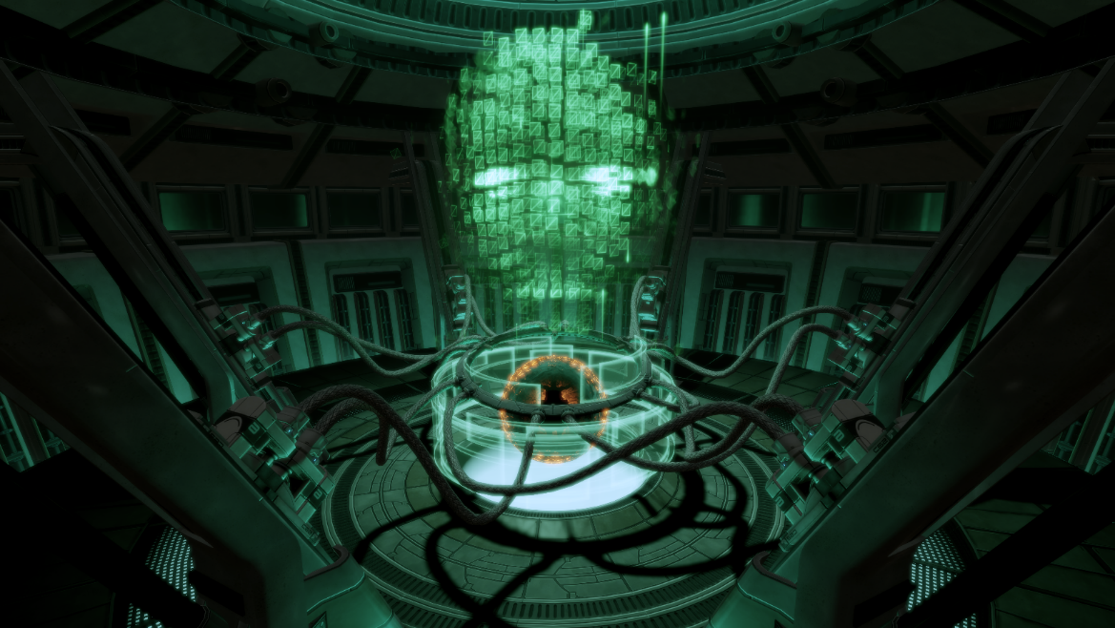
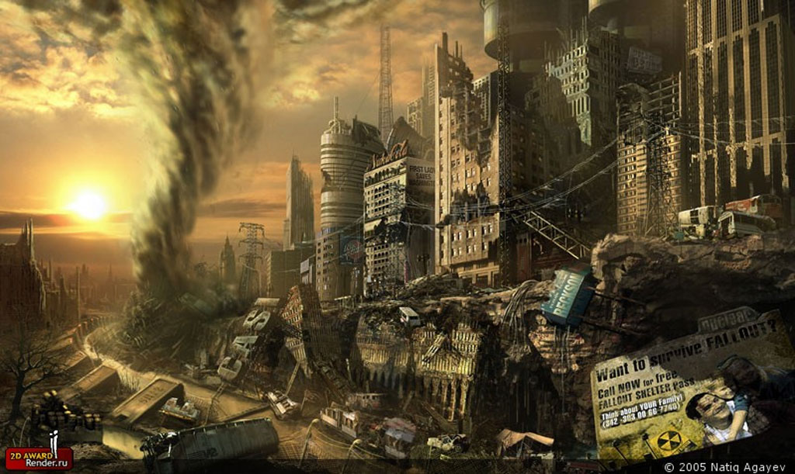
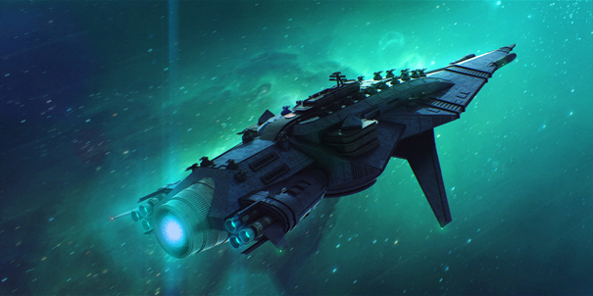

Introstory

Slide 5
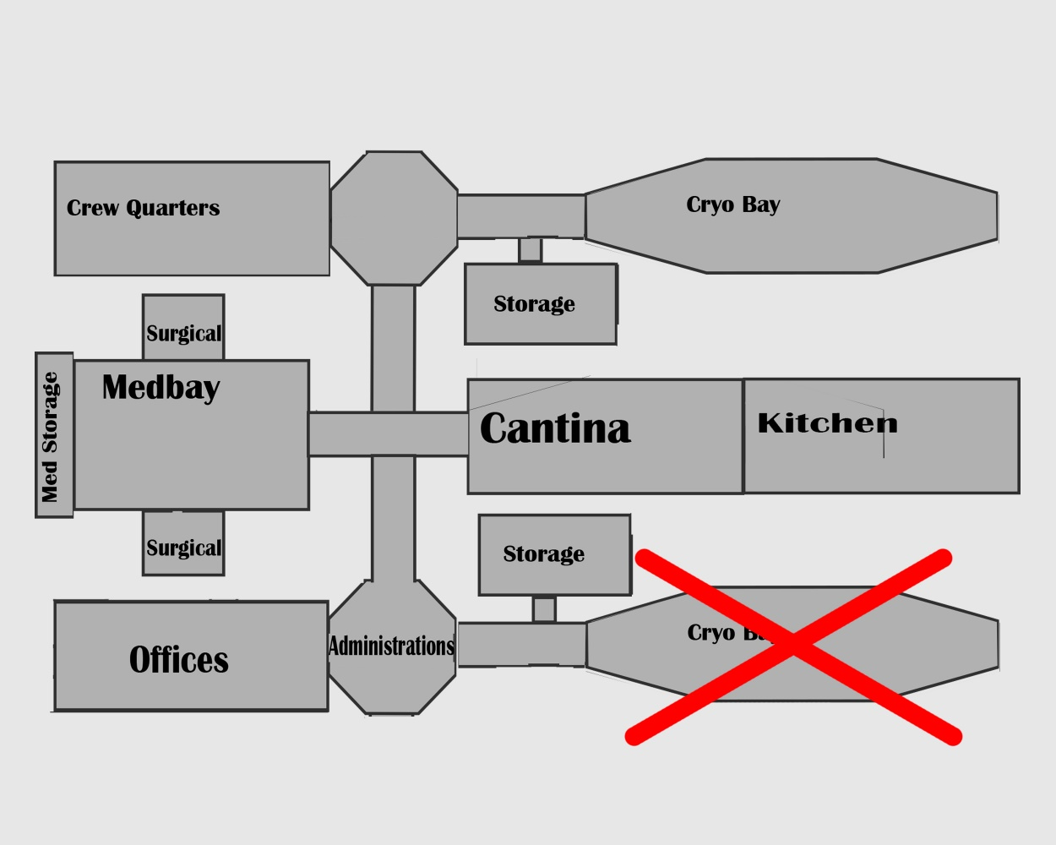
Uitleg Zones
Gameflow
Verdieping 2

Slide 6
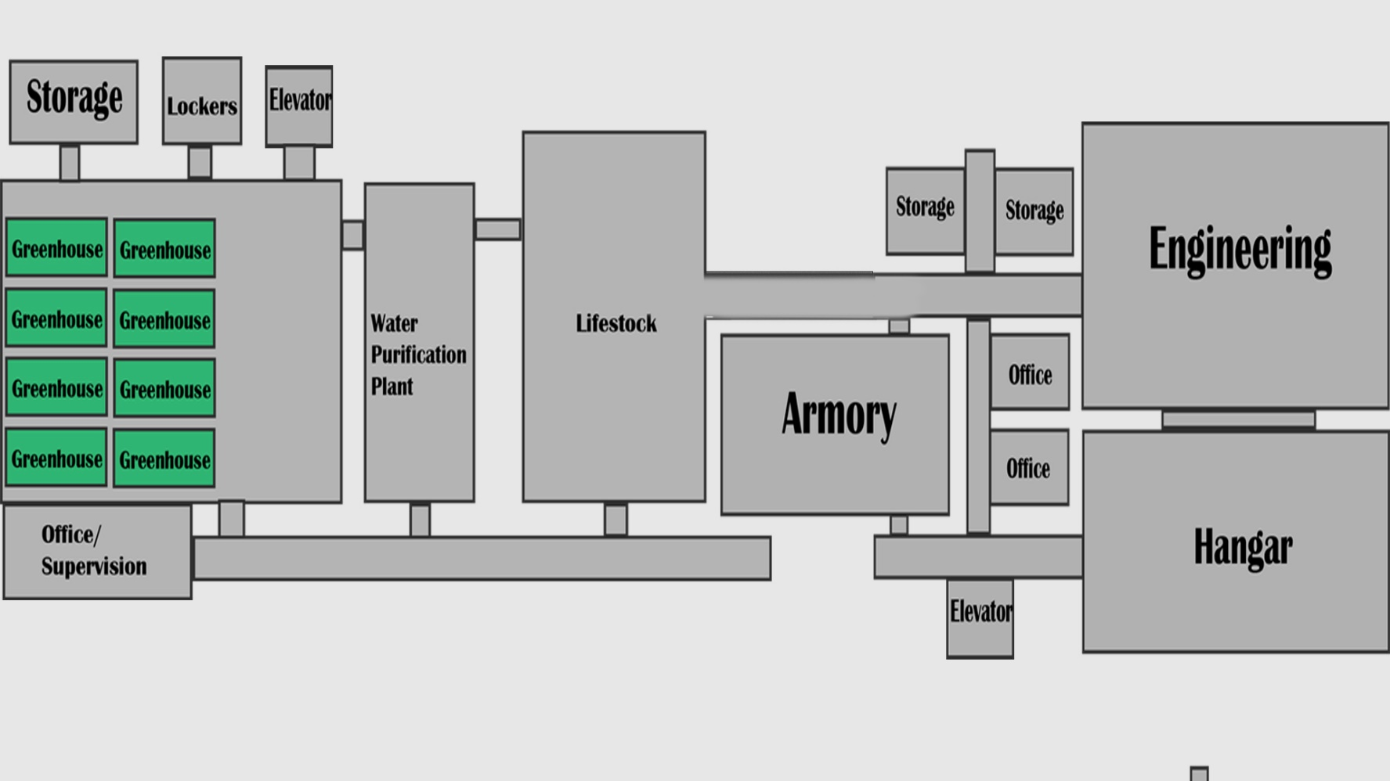
Uitleg Zones
Verdieping 1

Slide 7
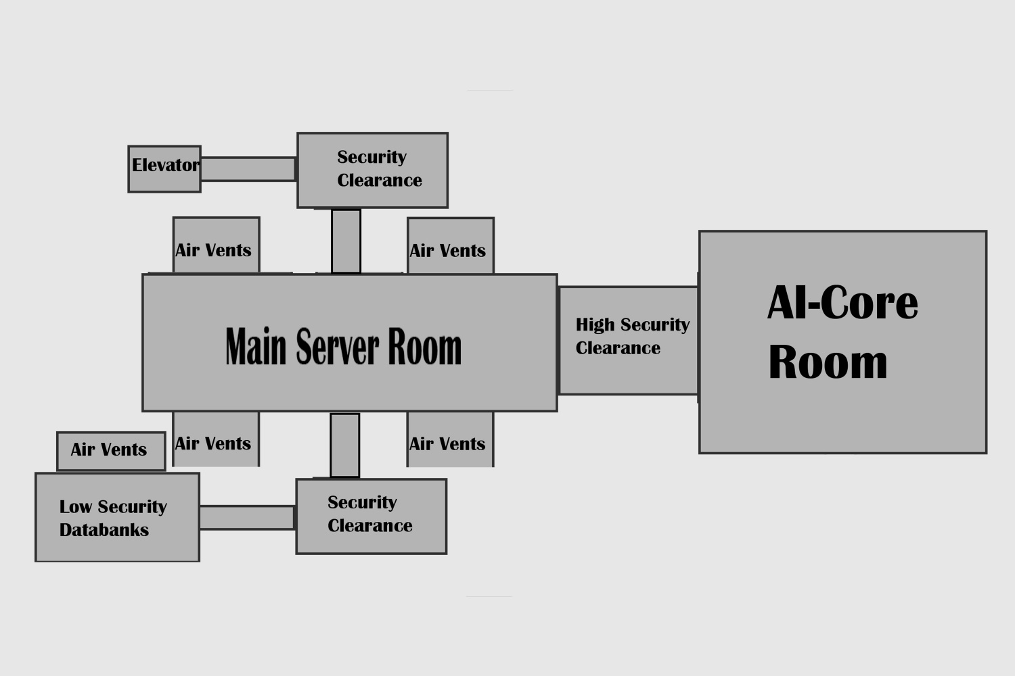
Uitleg Zones
Verdieping 0

Slide 8
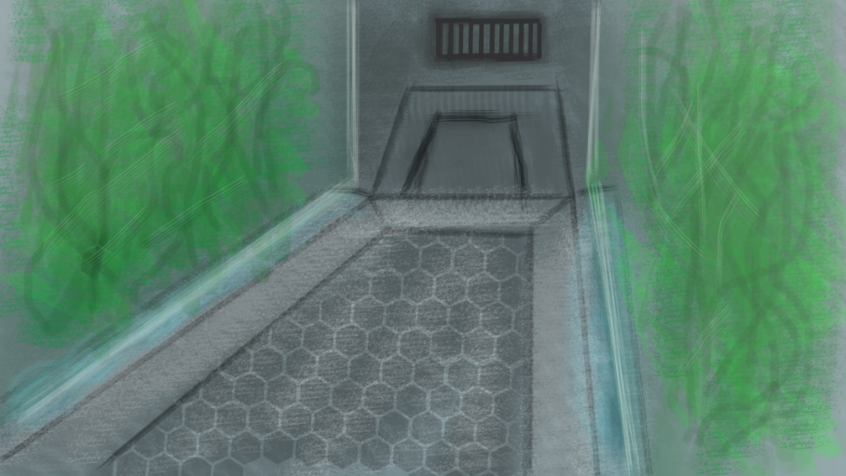
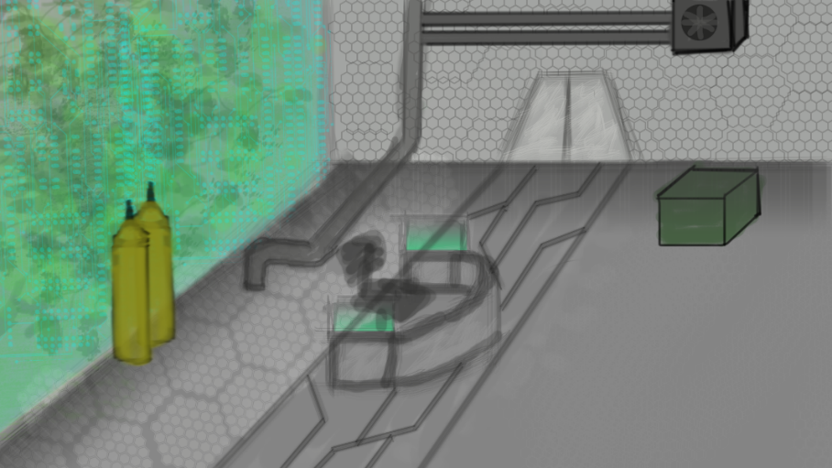
Game Mechanics
Mechanics Game
Player mechanic
Weapon mechanic (diverse ammo, wapens)
Med en stimpacks mechanic (uniek aspect)
Loot mechanic
Alarm mechanic (uniek aspect)
Enemy mechanic

Slide 9
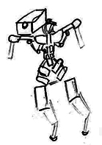
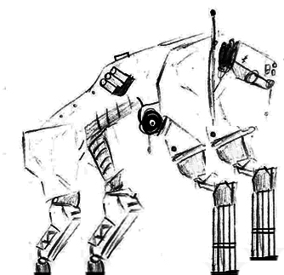
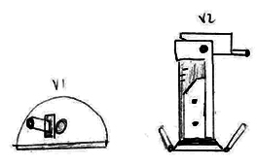
Enemies
Robots
Cameras
Proxies
Turrets
Roombas
Livestock
Mutated dogs
Mutated chickens
Special
Xenomorphic alien
Carnivorous plants

Slide 10
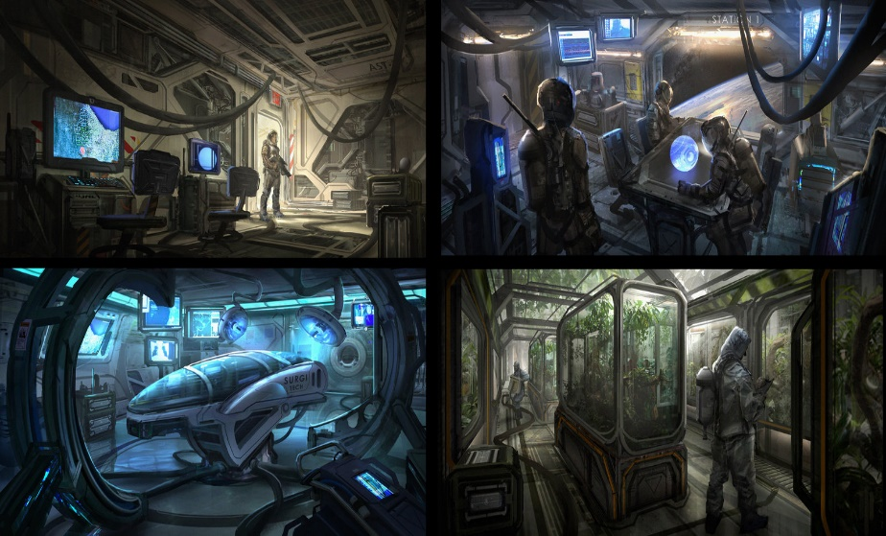
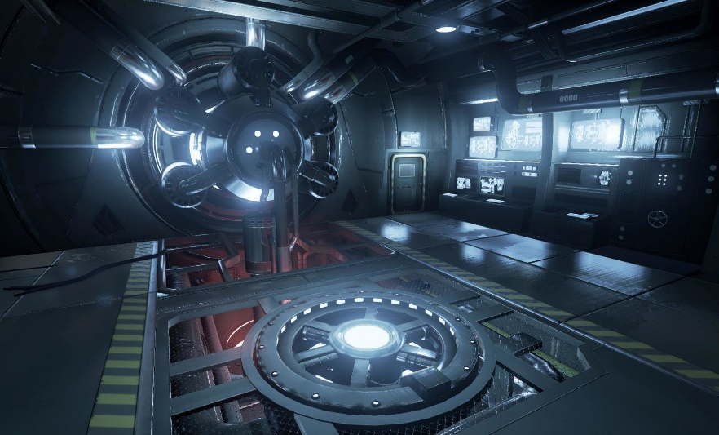
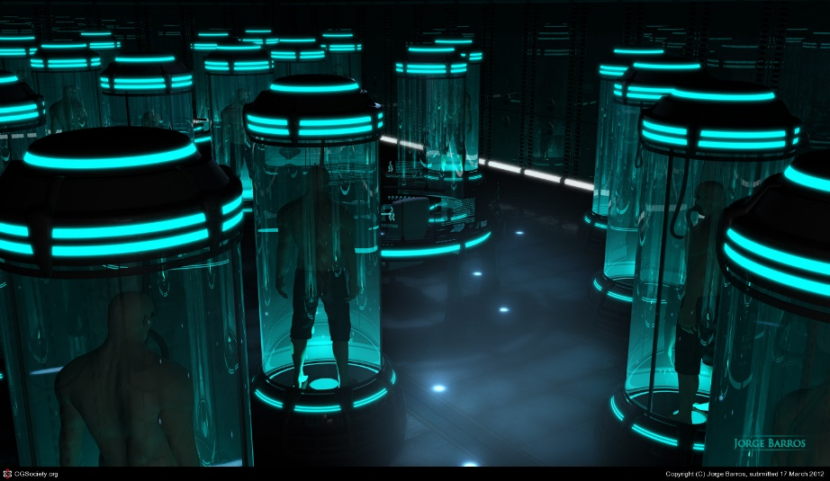
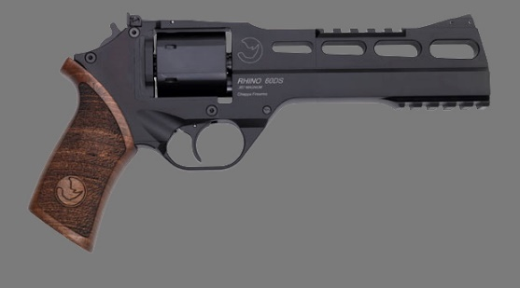
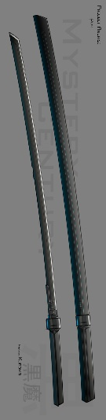
Art Style
PBR
Onderbouwing keuzen
Pre-productie

Slide 11
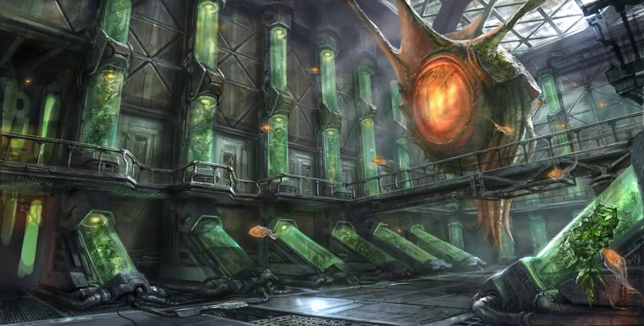
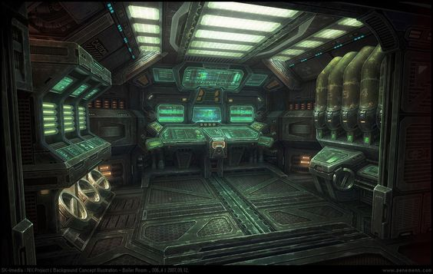
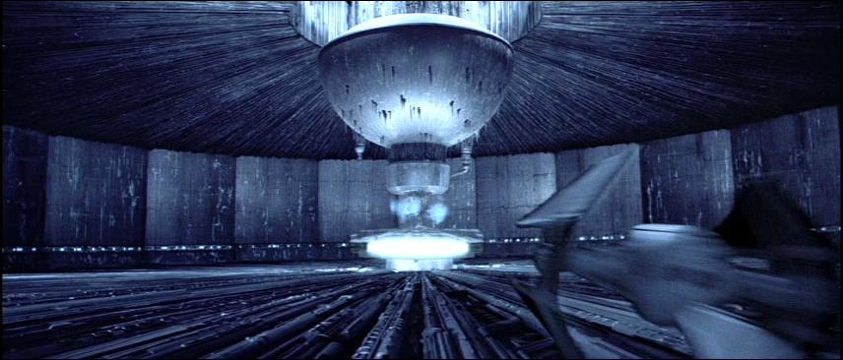
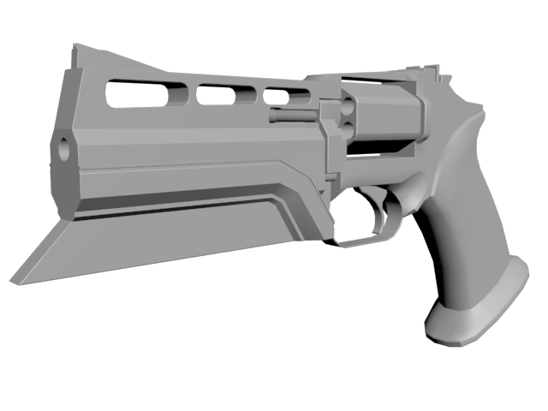
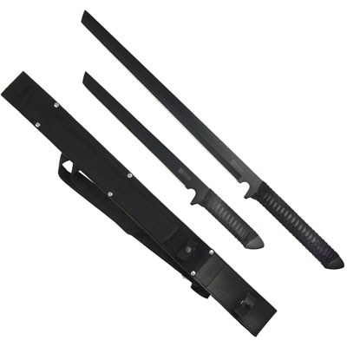
Art Style

Slide 12
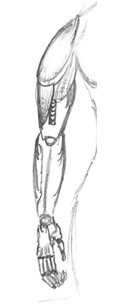
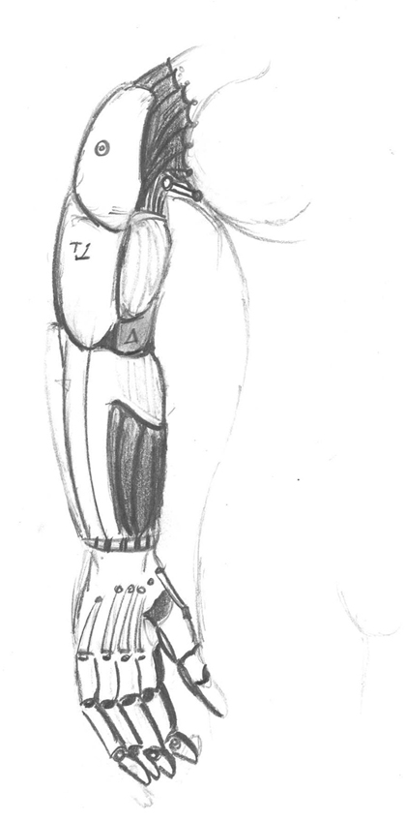
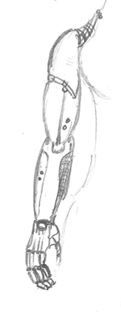
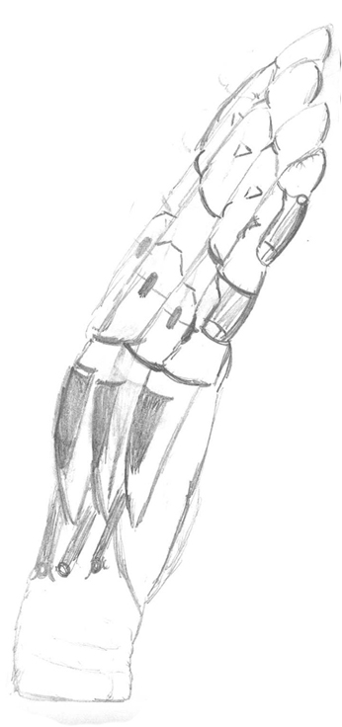
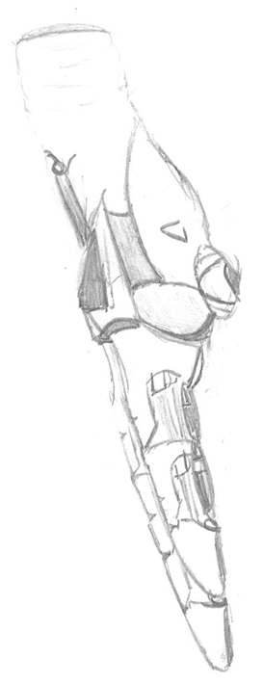
Art Style

Slide 13
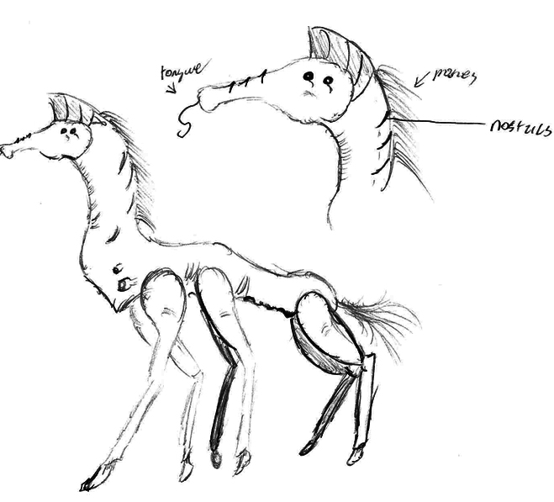
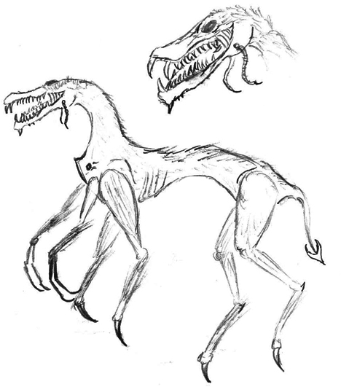
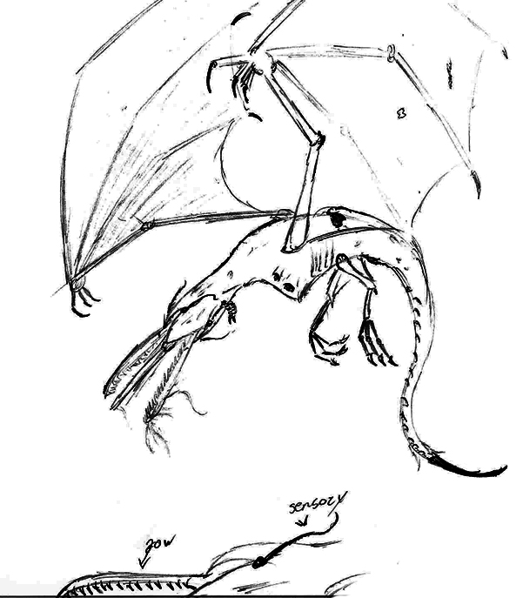
Art Style

Slide 14
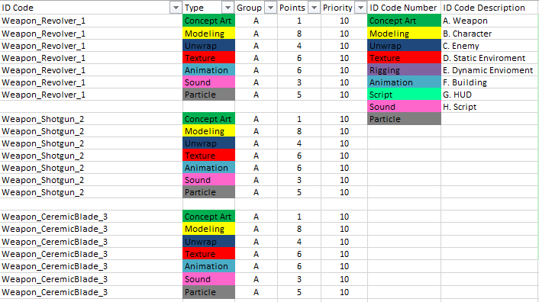
BackLog
Backlog (Asset-List)
Asset-List met puntensysteem

Slide 15
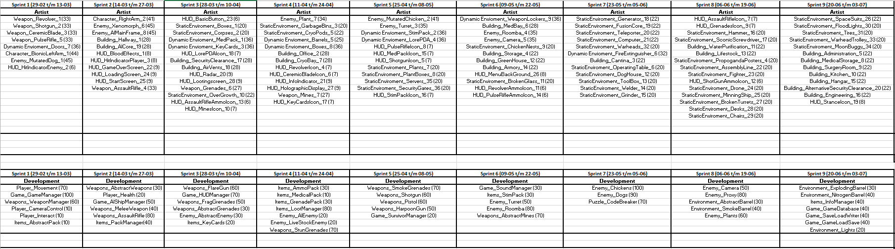
BackLog

Slide 16
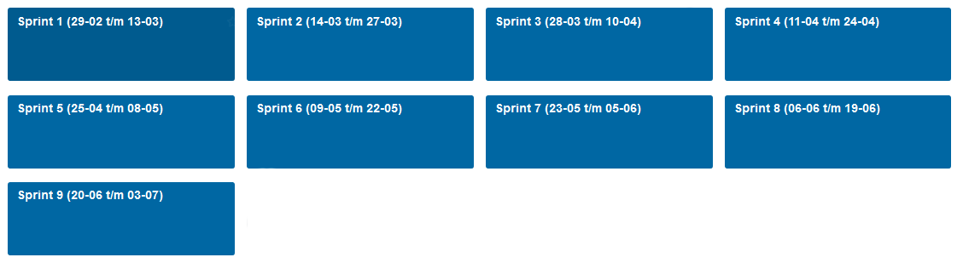
Trello
Planning in trello
Taakverdeling

Slide 17
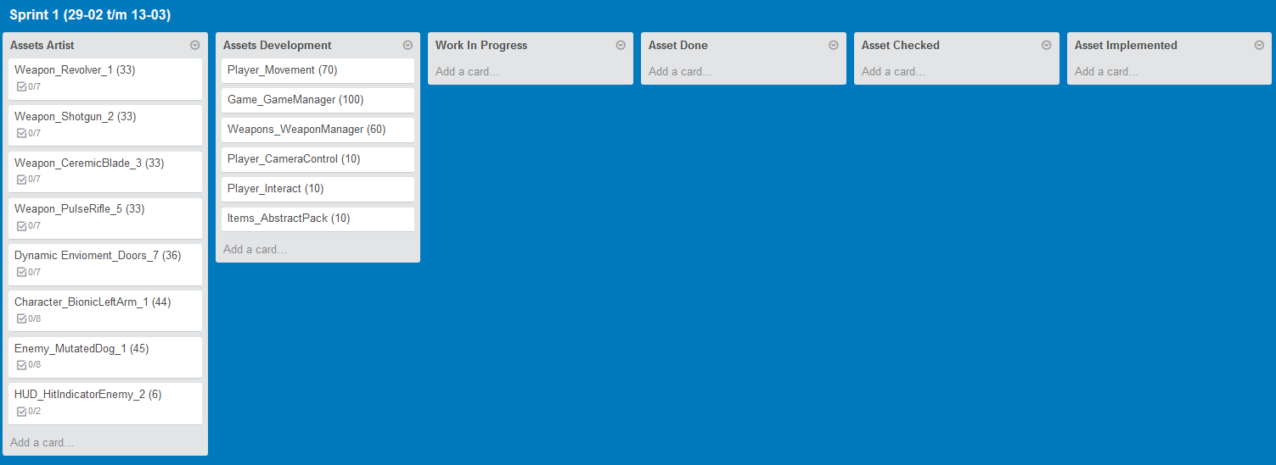
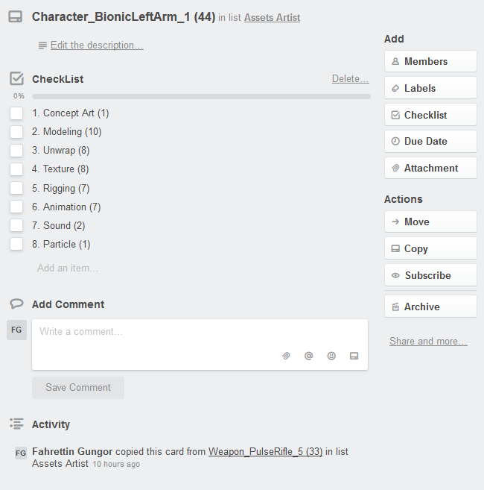
Trello

Slide 18
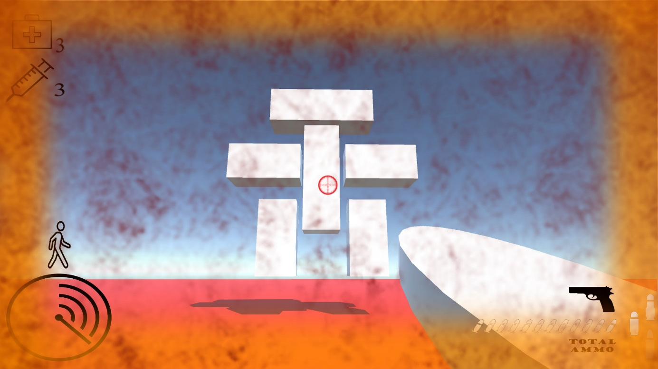
UX / Leveldesign
Puzzle (liften, code breken, keycards)
Fun to play factor
User interface (indicatie)

Slide 19
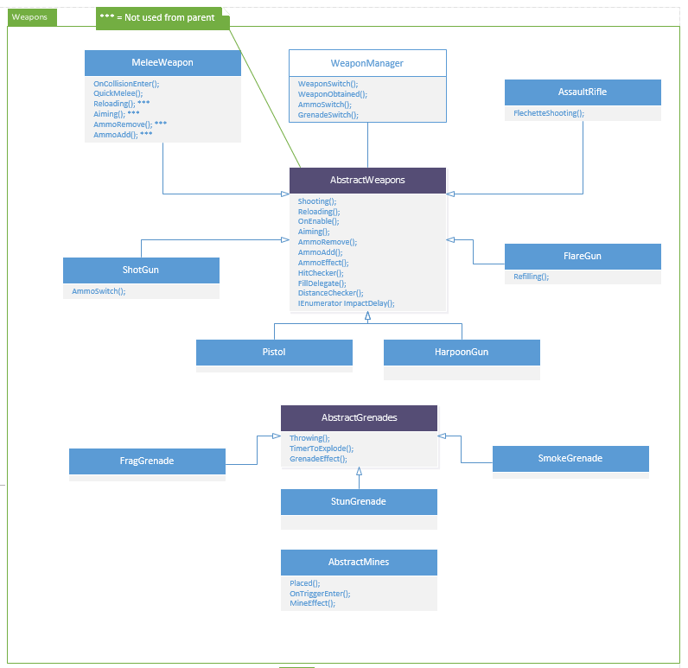
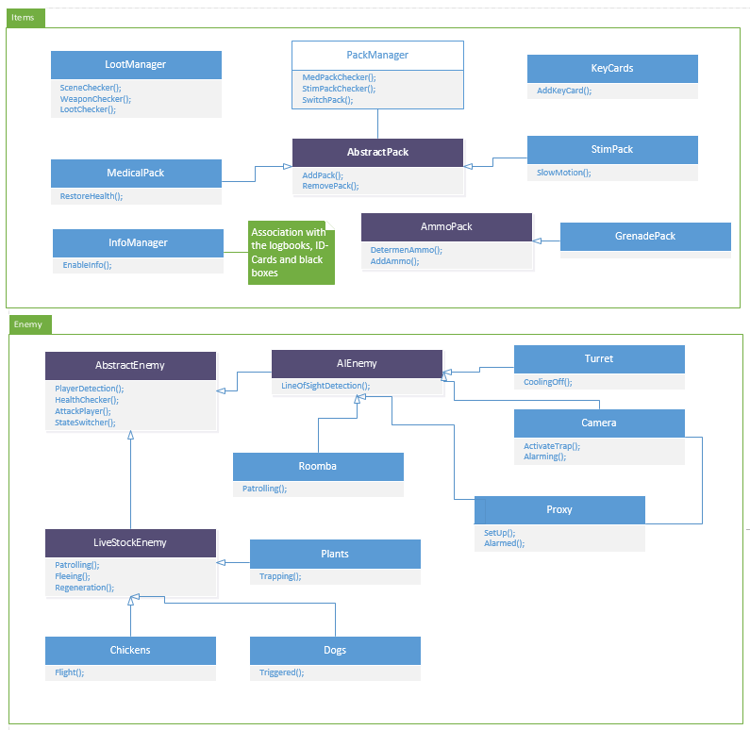
Scripting

Slide 20
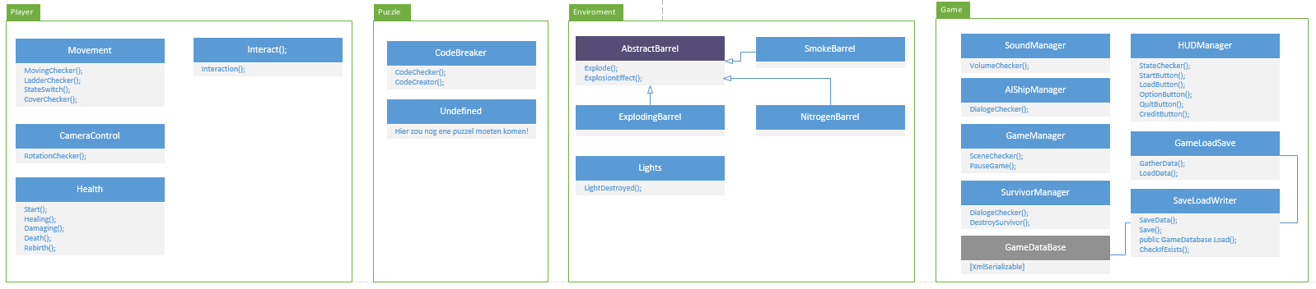
scripting

Slide 21
Doel
Doel Prototype development fase 2
Einddoel development fase 2

Slide 22
Vragen ?

